Slide 1
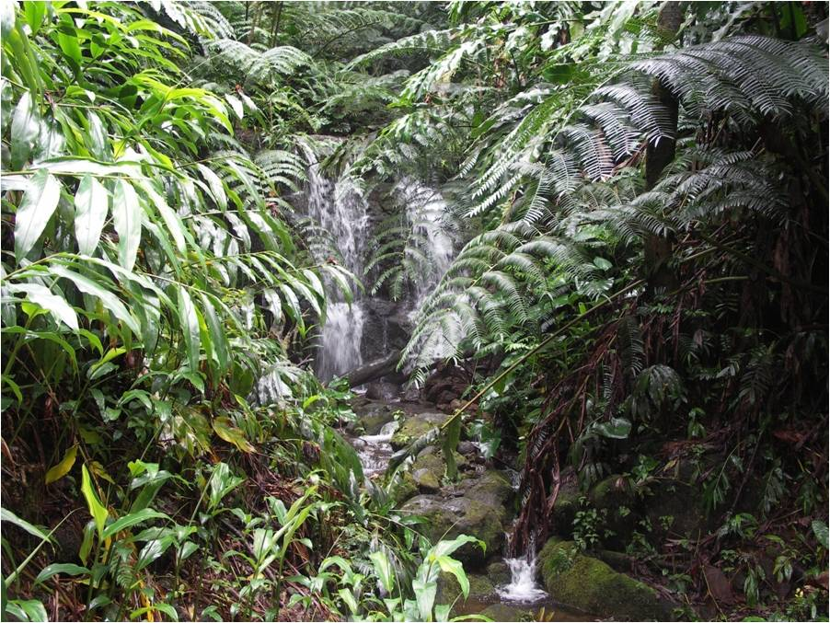
Ecology Tours Division
Lehua Adventure Tours

Slide 2
Sights of the Sacred Valley
Explore archaeological wonders of the Manoa Valley
Mondays from 8:00 a.m. – 2:00 p.m.
4 person minimum, 12 person maximum
Walking distance: 1-2 miles
Fee: $25.00

Slide 3
Lehua Ecology Day Tours
A member of the Hawaii Ecotourism Association and 2010 winner for the HEA Ecotour of the Year

