Slide 1
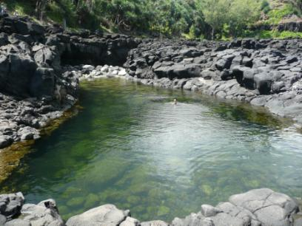
What is Ecotourism?
A commitment to environmental stewardship
A raised awareness of local culture
A travel agenda that reduces threats to wildlife and watershed
A responsible approach to minimizing the impact of tourism

Slide 2
Native Hawaii
Explore ancient and endangered plant species on this special one-mile hike through densely forested vegetation. Wednesdays from 1:00 to 5:00 p.m.

Slide 3
Spiritual Sea Cleanse
Explore a purifying wash of the sea at a small hidden beach

Slide 4
Snorkeling with Sea Turtles
Explore the underwater beauty of the islands without disturbing this protected sea creature

